Slide 1

Module 4 –Spark Streaming

Slide 2

Last Lecture…
SPARK STREAMING
Looked into…..
Basics of Streaming
What is Streamed Data?
How is streaming analytics differs from batch analytics?
Comparison of data in motion and data at rest.
Challenges for data at motion- in terms of storage and processing
DBMS Vs DSMS
Adhoc and Standing Queries
Can we use Hadoop for Stream Processing?
Difficulties with using Hadoop for Stream Processing
Stateful and Stateless processing
Fault tolerance of stateful processing.

Slide 3
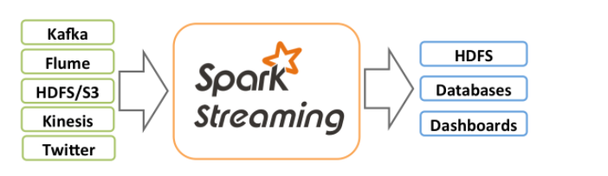
What is Apache Spark Streaming?
SPARK STREAMING
Spark Streaming is a library provided in Apache Spark for processing live data streams that is scalable, has high-throughput and is fault-tolerant.
Spark Streaming can ingest data from multiple sources such as Kafka, Flume, Kinesis or TCP sockets; and process this data using complex algorithms provided in the Spark API including algorithms provided in the Spark MLlib and GraphX libraries.
Processed data can be pushed to live dashboards, file systems and databases.
https://spark.apache.org/docs/latest/streaming-programming-guide.html#:~:text=Spark%20Streaming%20is%20an%20extension,processing%20of%20live%20data%20streams.&text=Spark%20Streaming%20provides%20a%20high,a%20continuous%20stream%20of%20data.

Slide 4
Spark Streaming Architecture- Discretized Streams
SPARK STREAMING
Data Streams
Receivers
RDD
Batches of data for a given time increment
RDD
RDD
Transform and output to other system

Slide 5
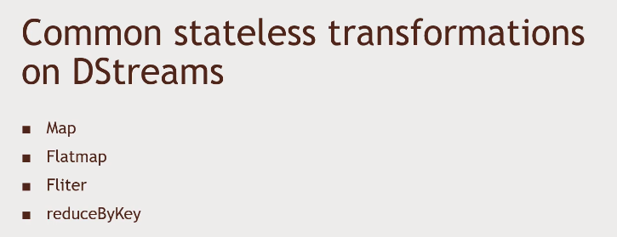
D Streams
SPARK STREAMING
Generates the RDD’s for each time step, and can produce output at each time step
Can be transformed and acted on in much the same way as RDD’s
Can access underlying RDD’s if required

Slide 6
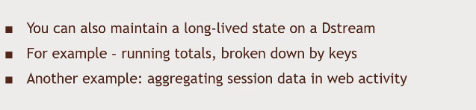
Stateful Data
SPARK STREAMING

Slide 7

Windowing
SPARK STREAMING
Compute results across longer time period than batch interval
Example: top-sellers from the past hour
-You might process data every one second
-But maintain a window of one hour
The window slides as time goes on to represent batches within the time interval

Slide 8
Batch interval Vs Slide interval Vs Window interval
SPARK STREAMING
How often data is captured into a Dstream
How often a windowed transformation is computed
How far back in time the windowed transformation goes

Slide 9
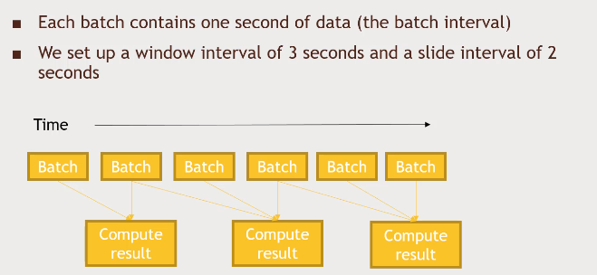
Batch interval Vs Slide interval Vs Window interval
SPARK STREAMING

Slide 10
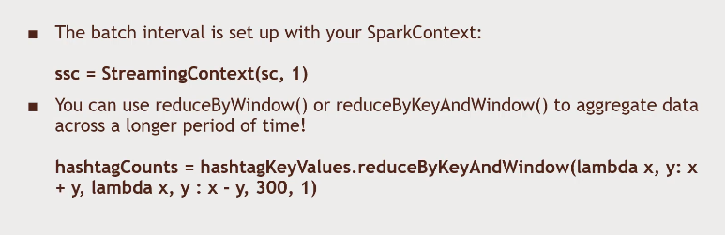
Windowed Transformations:Code
SPARK STREAMING

Slide 11
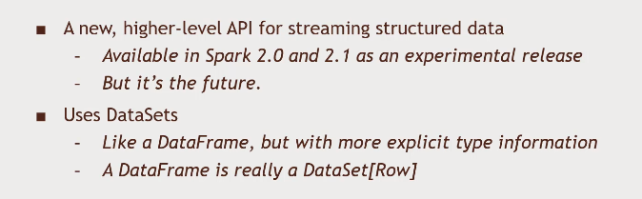
Structured Streaming
SPARK STREAMING

Slide 12
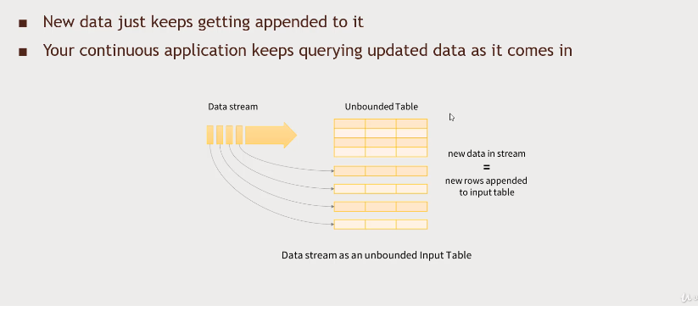
Structured Streaming
SPARK STREAMING

Slide 13
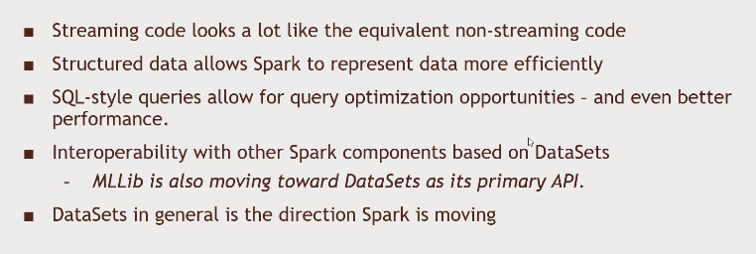
Advantages of Structured Streaming
SPARK STREAMING

Slide 14
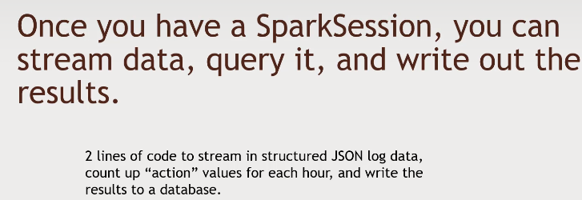

Advantages of Structured Streaming
SPARK STREAMING

Slide 15
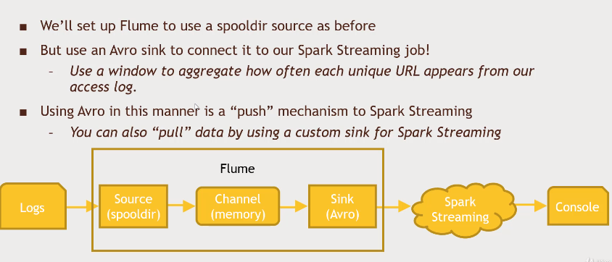
Spark Streaming with Flume
SPARK STREAMING

Slide 16
Spark Streaming
Question No:1
Input Stock Data Stream: num_stock
Can we modify Hadoop?
Suppose we don’t want instantaneous updates
Say 1 second updates are acceptable
Can we modify Hadoop to do stream processing?
Ignore the global variable problem for now
Find_max: If num_stock > Max_num_stock
Max_num_stock = num_stock
Max_num_stock

Slide 17
Spark Streaming
Question No:1 Solution
We can batch input records into an HDFS file
We can batch together the inputrecords every second
This file can be processed using MapReduce
We can produce an update every second
We have ignored the global variable problem for now
Input Stock Data Stream: num_stock
Batcher: group together records every second into an HDFS file
Find_max: If num_stock > Max_num_stock
Max_num_stock = num_stock
Max_num_stock

Slide 18
Spark Streaming
Question No:2
What is Discretized Spark Streaming?

Slide 19
Spark Streaming
Question No:2 Solution
Run a streaming computation as a series of very small, deterministic batch jobs
live data stream
Spark
Streaming
Chop up the live stream into batches of X seconds
Spark treats each batch of data as RDDs and processes them using RDD operations
Finally, the processed results of the RDD operations are returned in batches
batches of X seconds
Spark
processed results

Slide 20
Stream Processing
Question No:3
Consider a Dstream on twitter data
A sequence of tuples that contain <user name, Password>
Need to get Hash tags from Twitter
Show Streaming spark design for the same.

Slide 21
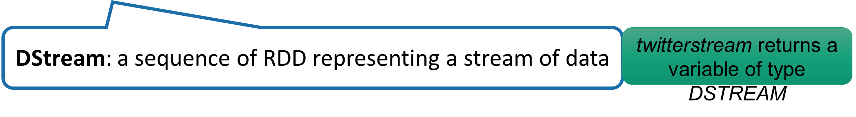

BIG DATA
Example 1 – Get hashtags from Twitter
val tweets = ssc.twitterStream(<Twitter username>, <Twitter password>)
Twitter Streaming API
batch @ t
batch @ t+1
batch @ t+2
tweets DStream
stored in memory as an RDD (immutable, distributed)

Slide 22
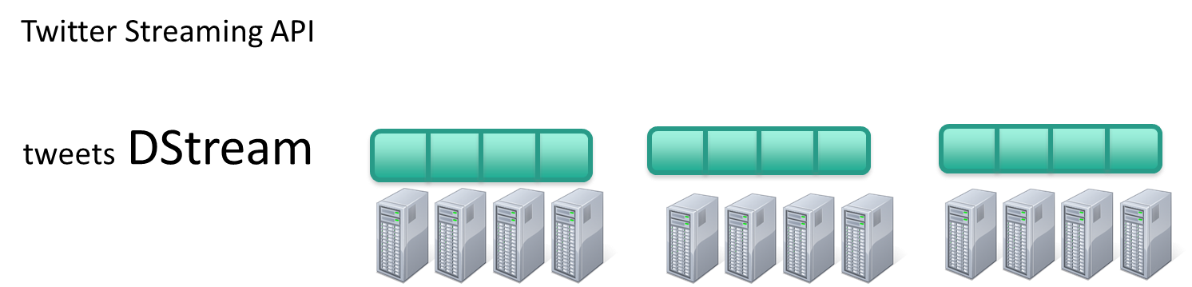


BIG DATA
Example 1 – Get hashtags from Twitter
val tweets = ssc.twitterStream(<Twitter username>, <Twitter password>)
val hashTags = tweets.flatMap (status => getTags(status))
val tweets = ssc.twitterStream(<Twitter username>, <Twitter password>)
new DStream
transformation: modify data in one Dstream to create another DStream
getTags is a function. A DStream is a sequence of RDDs. The function is applied to each RDD. The result is another DStream
batch @ t
batch @ t+1
batch @ t+2
flatMap
flatMap
flatMap
hashTags Dstream
[#cat, #dog, … ]

Slide 23
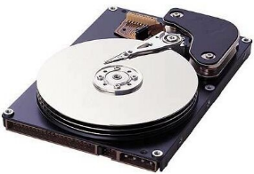
BIG DATA
Example 1 – Get hashtags from Twitter
val tweets = ssc.twitterStream(<Twitter username>, <Twitter password>)
val hashTags = tweets.flatMap (status => getTags(status))
hashTags.saveAsHadoopFiles("hdfs://...")
output operation: to push data to external storage
tweets DStream
batch @ t
batch @ t+1
batch @ t+2
flatMap
flatMap
flatMap
hashTags DStream
Every batch saved to HDFS
save
save
save

Slide 24
Spark Streaming
Question No:4
Can you visualize the Spark Streaming Flow?

Slide 25
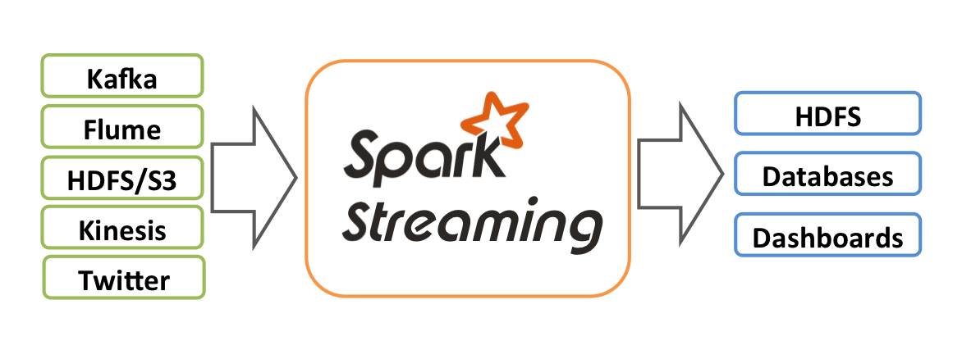
BIG DATA
Streaming Spark Flow
Dstreams and Receivers
Twitter, HDFS, Kafka, Flume
Transformations
Standard RDD operations – map, countByValue, reduce, join, …
Stateful operations – window, countByValueAndWindow, …
Output Operations on Dstreams
saveAsHadoopFiles – saves to HDFS
foreach – do anything with each batch of results

Slide 26
Spark Streaming
Question No:5
What are the different type of file sources for Spark Streaming?

Slide 27
Spark Streaming
Question No:5 Solution
Types of sources
Basic – file systems and sockets
Advanced – Kafka, flume

Slide 28
Spark Streaming
Question No:6
What is the relationship between Dstream and RDD?

Slide 29
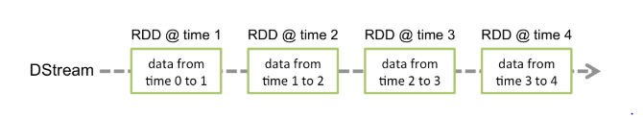
Spark Streaming
Question No:6 Solution

Slide 30
Spark Streaming
Question No:7
Consider a Dstream on stock quotes generated similar to earlier that contains
A sequence of tuples that contain <company name, stock sold>
Need to find total shares sold per company in the last 1 minute
Show Streaming spark design for the same.

Slide 31
BIG DATA
Solution – count stock in every window
batch @ t
batch @ t+1
batch @ t+2
Stocks sold Stream
map
map
map
hashTags DStream
count
count
count
every batch processed independently, so no state across time

Slide 32
THANK YOU

